Slide 1
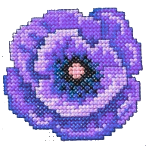

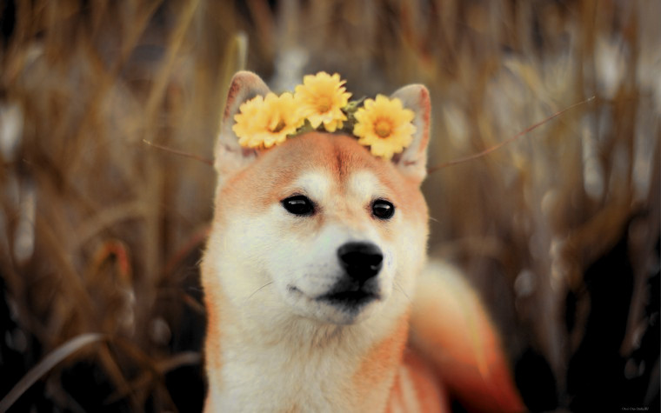
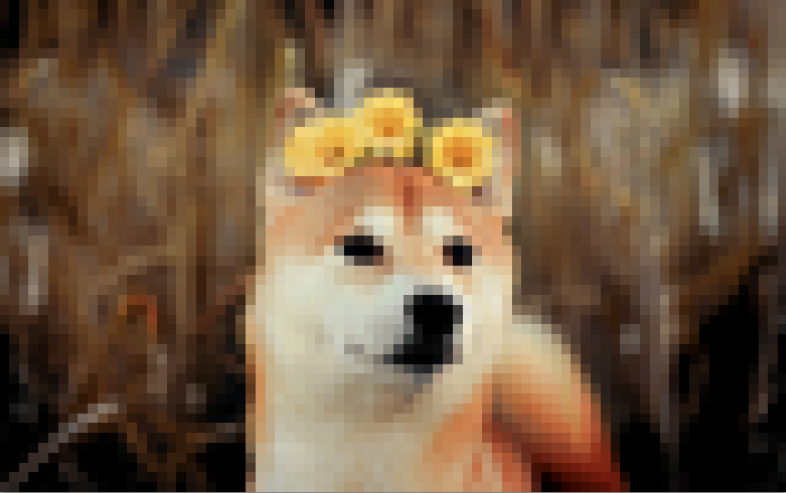
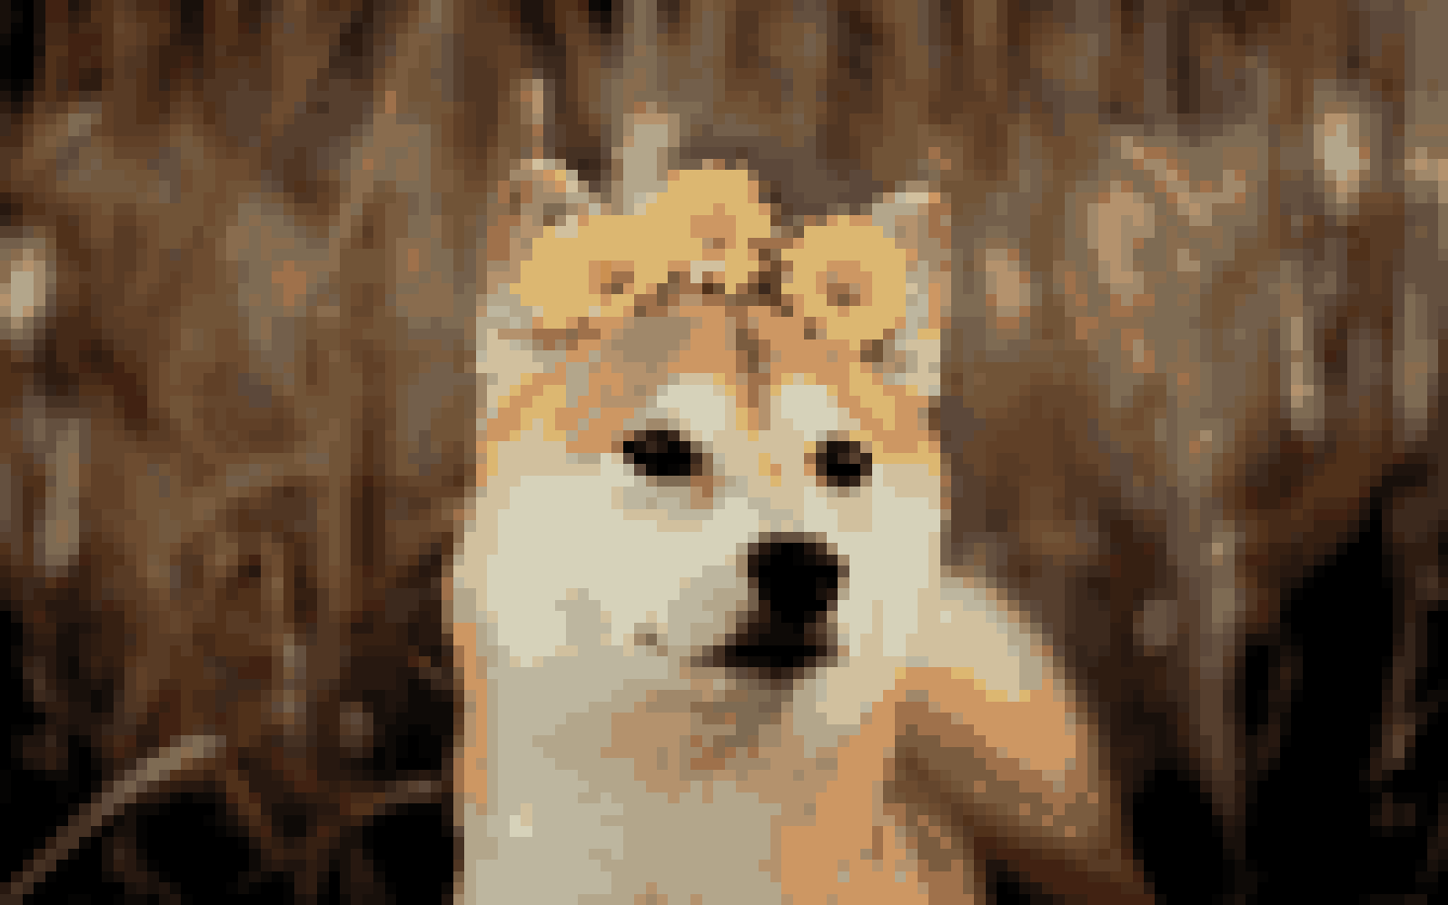
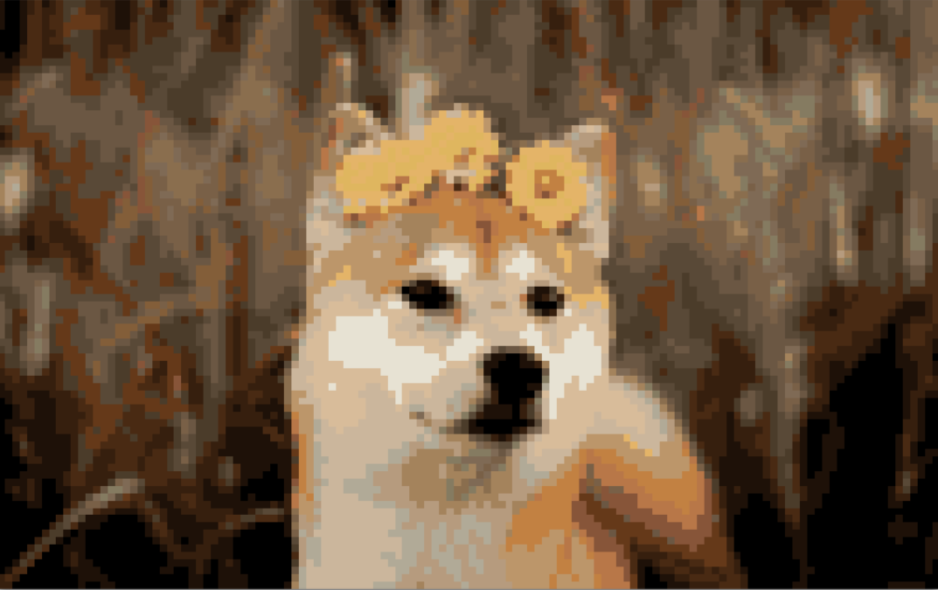
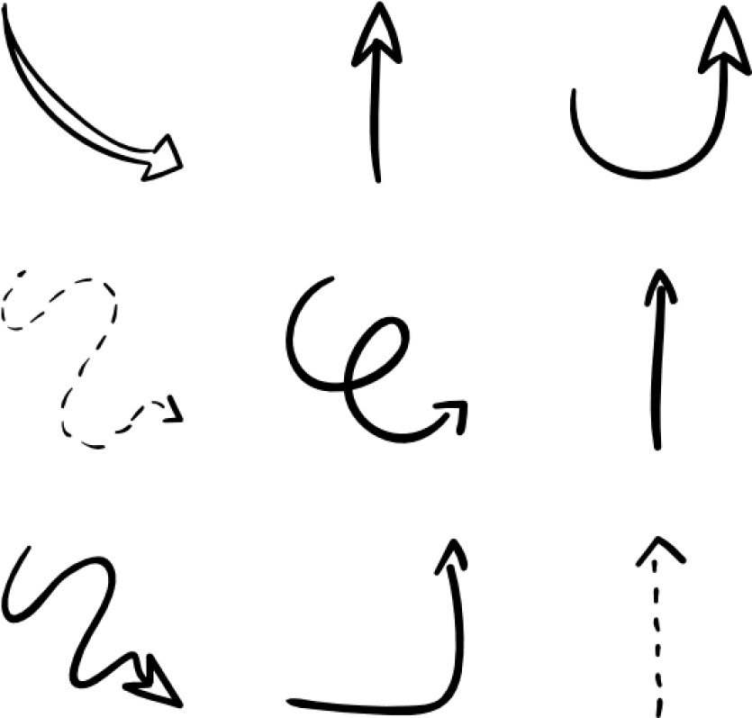
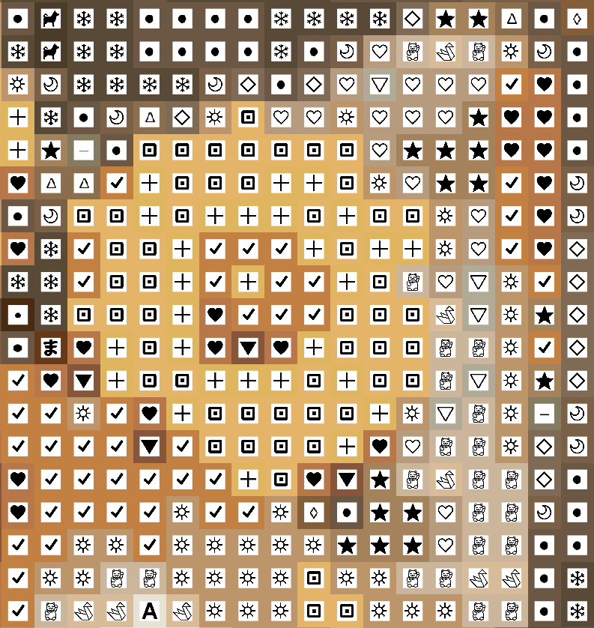
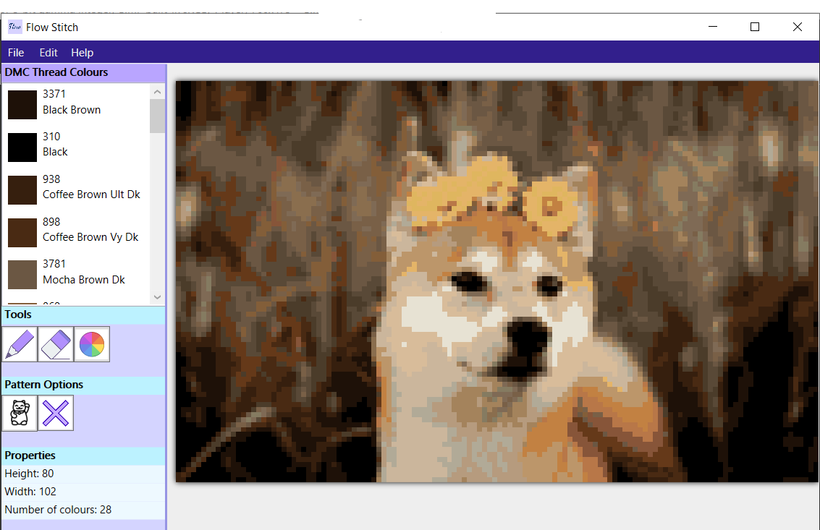
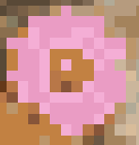
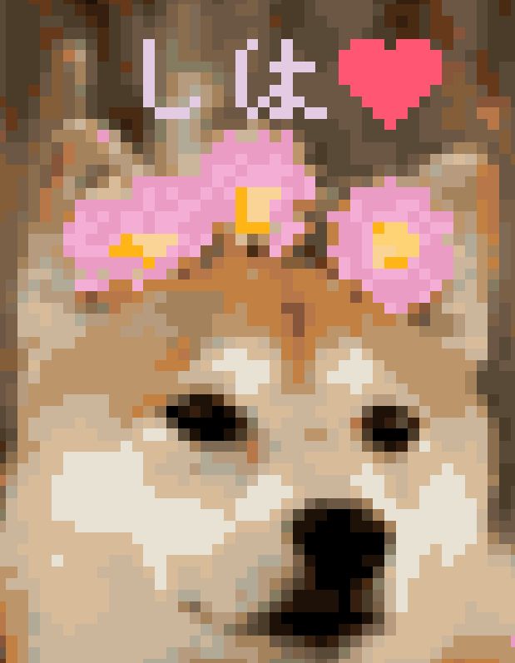
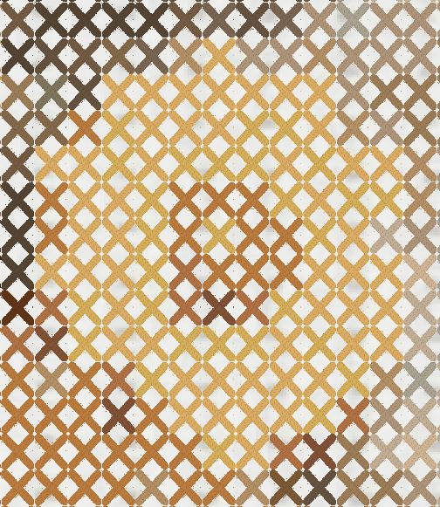
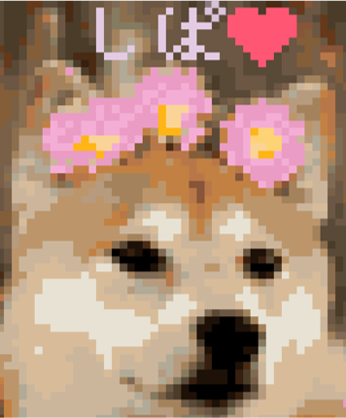

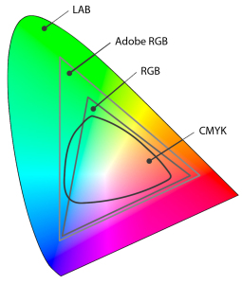

Cross Stitch Pattern Generator
by Lili Veszeli
A Windows application that creates a cross stitch pattern based on an image.
Downsampling
1st step
Quantization
2nd step
The image is downscaled as the first step of the pattern generation process, to get the pixelated effect that resembles stitches. The desired height is chosen by the user. As much details should be preserved as possible, so a high quality bicubic downscaling algorithm is used.
The number of colours in the image is reduced next, which is called quantization. The maximum number of colours is chosen by the user. These colours are then converted to real life DMC thread colours. This step helps to minimize the number of threads the user needs to buy.
Additional Features
Technical Details
The pattern can be edited after it is generated by drawing on it or erasing stitches. The colours in the palette can be changed or deleted.
The pattern can be saved with symbols on top of the stitches, making it simpler to differentiate colours.
A preview feature is available too, which shows how the pattern will look when finished.
The undo/redo feature ensures that the user is allowed to make mistakes.
The application was developed in WPF (Windows Presentation Foundation) using techniques from Agile methodology. The user interface was created in XAML, and the code behind was written in C#.
The palette colours are converted into Lab colour
space to get a better match when converting to DMC colours.
The preview uses a pixel shader written in HLSL with multiplicative colour blending.
Supervisor: Laurent Noel BSc (Hons) Computer Games Development
Supervisor: Laurent Noel BSc (Hons) Computer Games Development

